Slide 1

Project Presentation
Individual Project - 2021 Academic Year
KUR/IT/2021/F/009
H.M. Sahan Sachintha

Slide 2
content
purpose
Introduction
Technology
Project model
End

Slide 3
purpose
For the stop physical contact with dustbins
To prevent the spread of viruses from dustbins.
Easy to use
There is a risk of spreading infectious diseases in today society. As an example point to corona epidemic. Most of the dustbins used in the market need to be opened physically. The aim is to Prepare a plan that’s works automatically as a solution to these viruses being ingested from those trash bins.

Slide 4
introduction
This is a smart dustbin.
It has make using Arduino software.
It is a work Automatically.

Slide 5


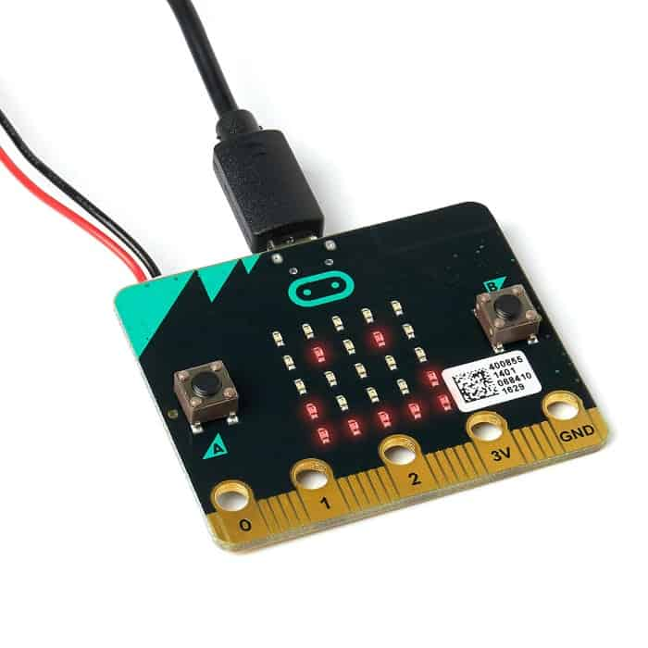

technology

Slide 6
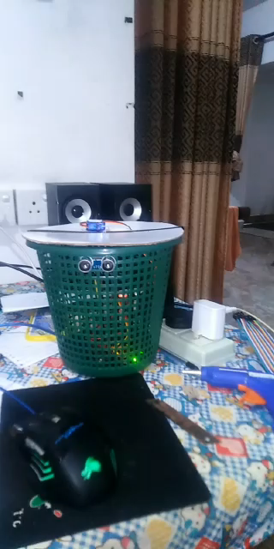
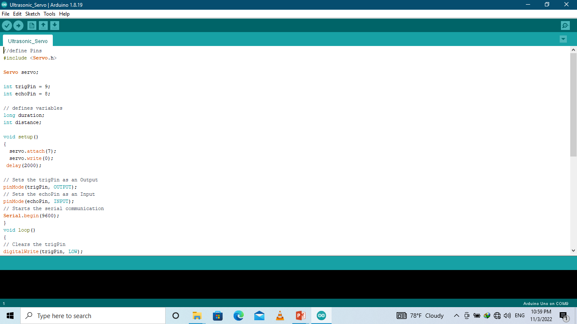
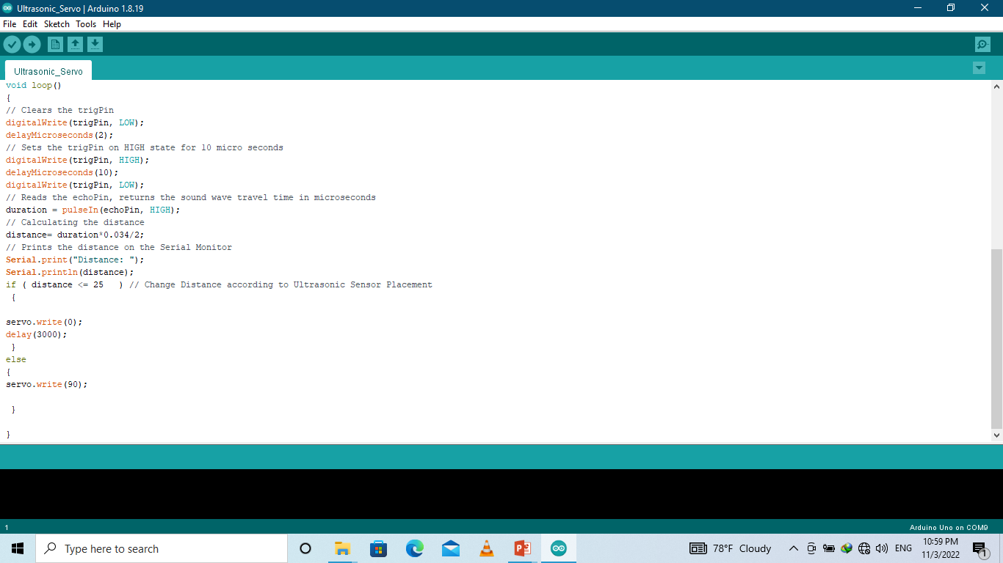
Project model

Slide 7
End
Thank You….!

